Slide 1
What are forces?

Slide 2
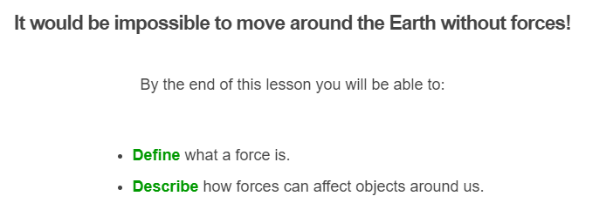

Slide 3
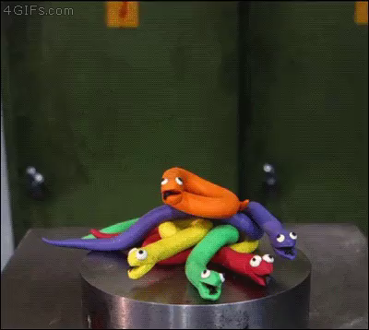
What are forces?
A force is a push or a pull applied to one object by another object.
We may not be able to see a force, but we can tell that it's there because it changes an object's motion or shape.

Slide 4
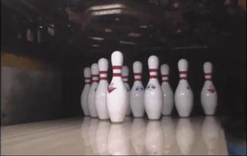
A force affects the object it is applied to.
For example, if you push a bowling ball, it will start to roll. This is because you are applying a force to the ball.
When you twist a piece of cloth in your hands, its shape changes because you're pulling on it.

Slide 5
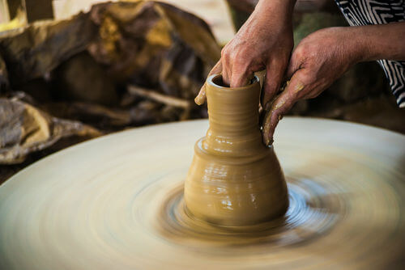
We say that a force is any influence that changes the speed, shape or direction of an object.
When you squeeze, roll or stretch clay, it changes shape. This is because you are applying a force.

